Slide 1
HeLA

Slide 2
Orientations

Slide 3
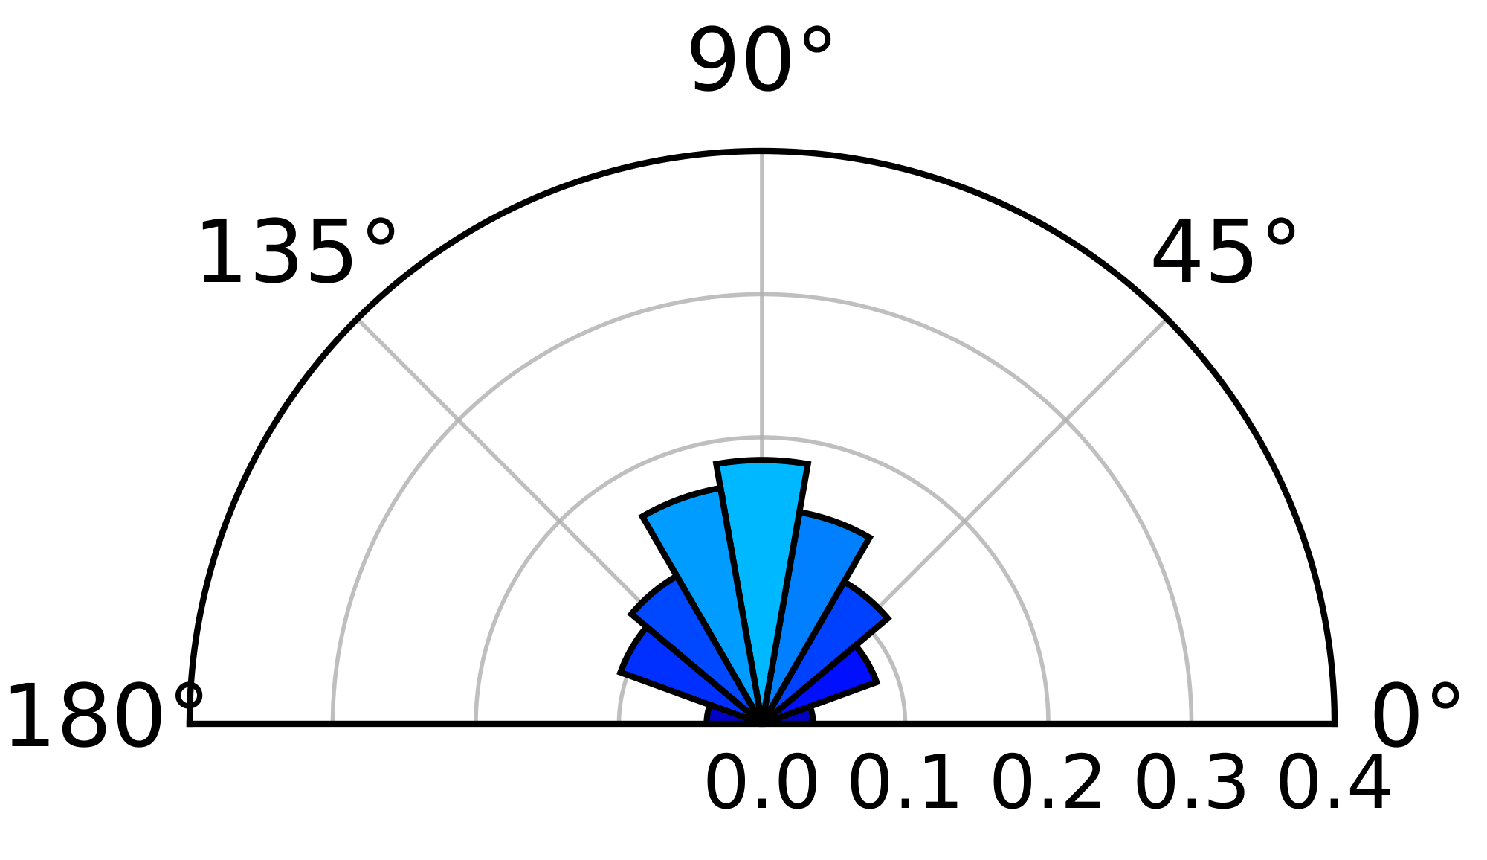
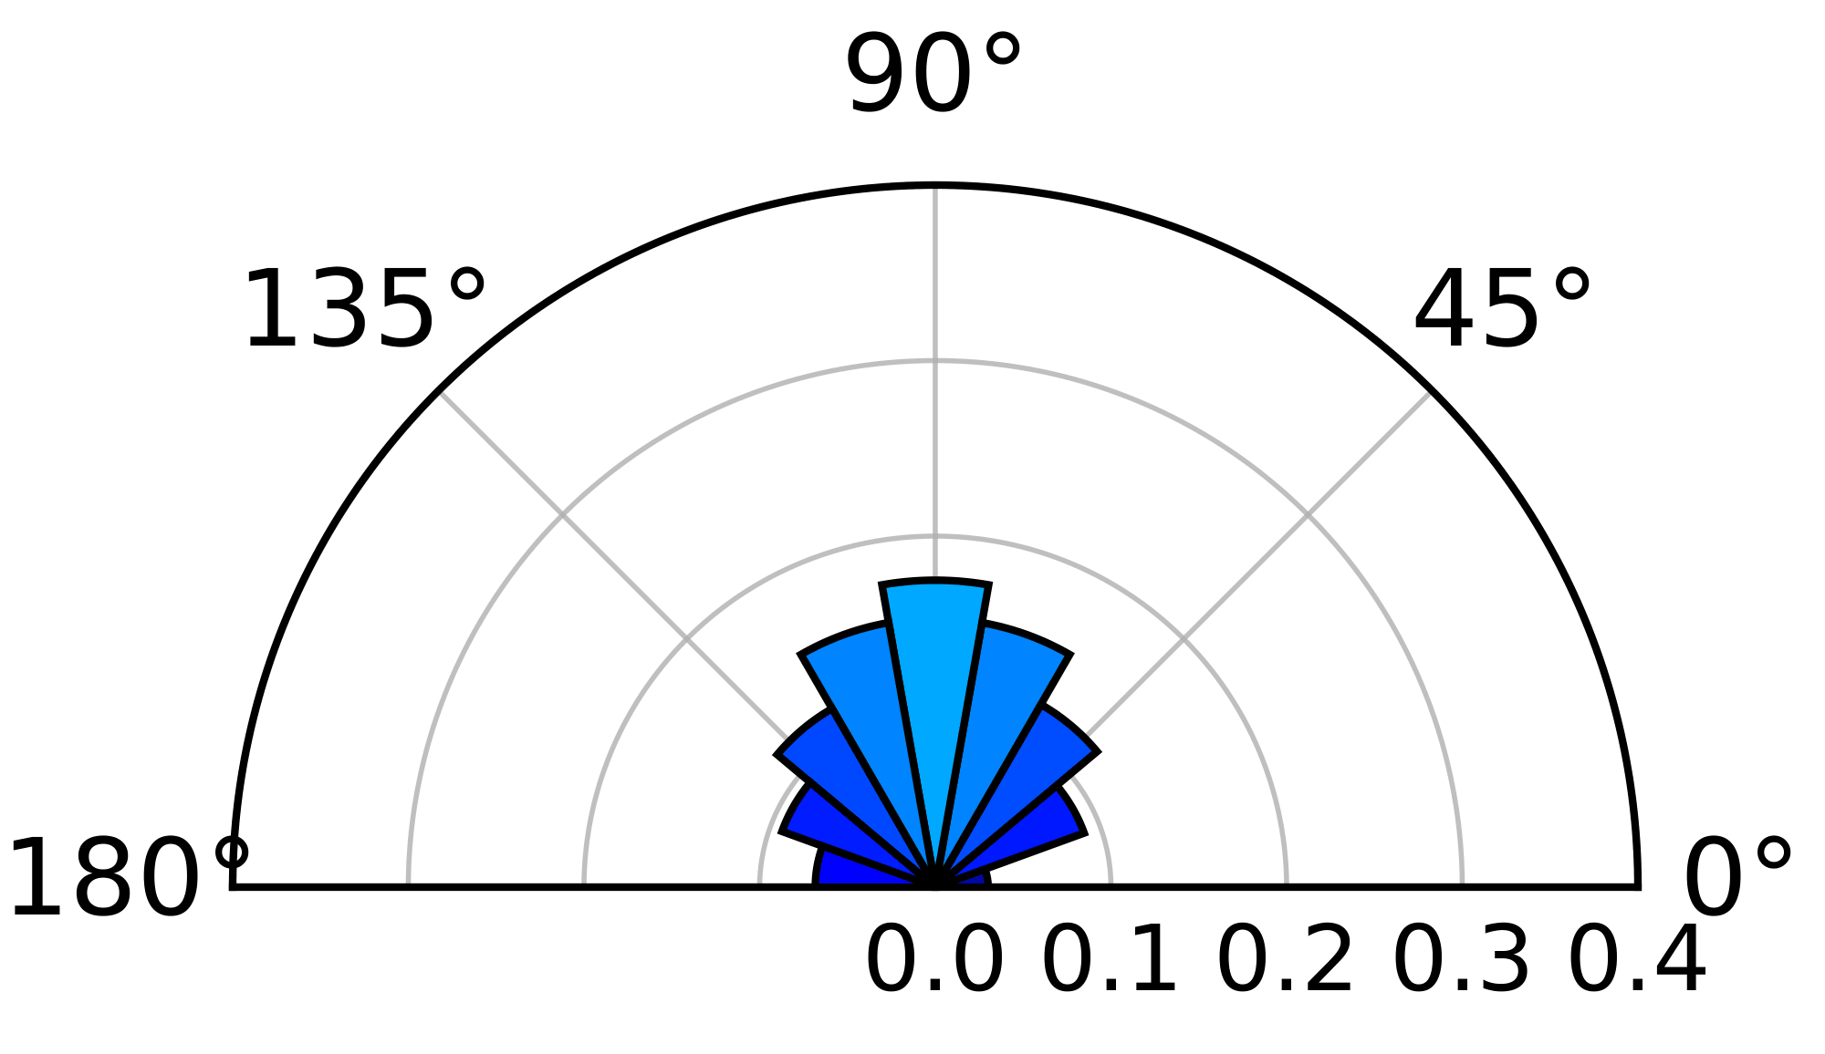
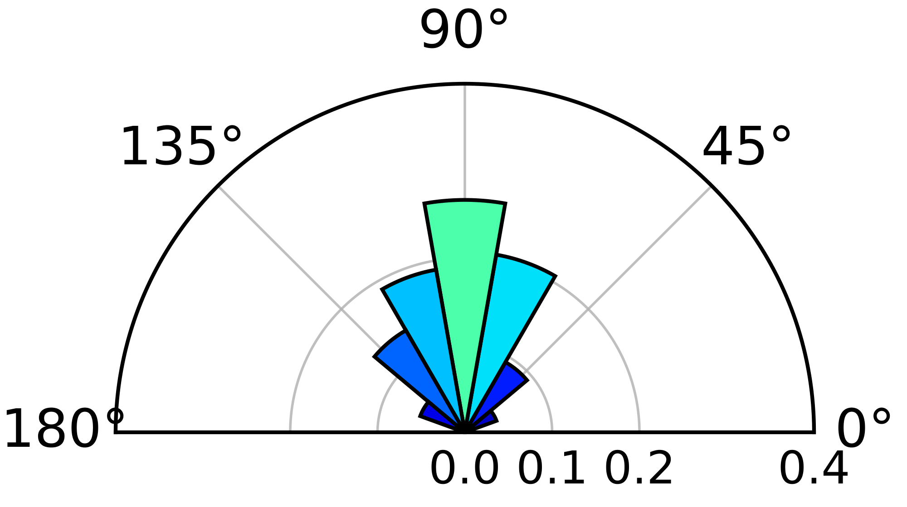
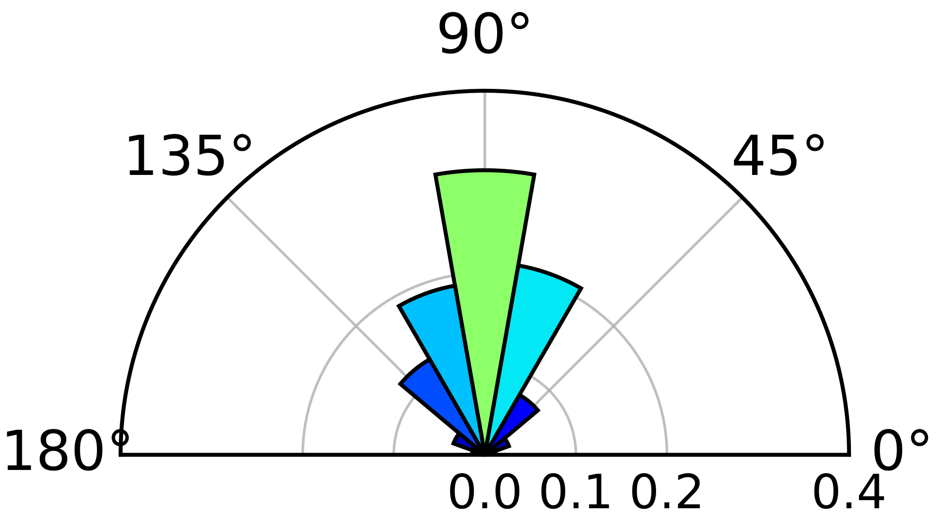
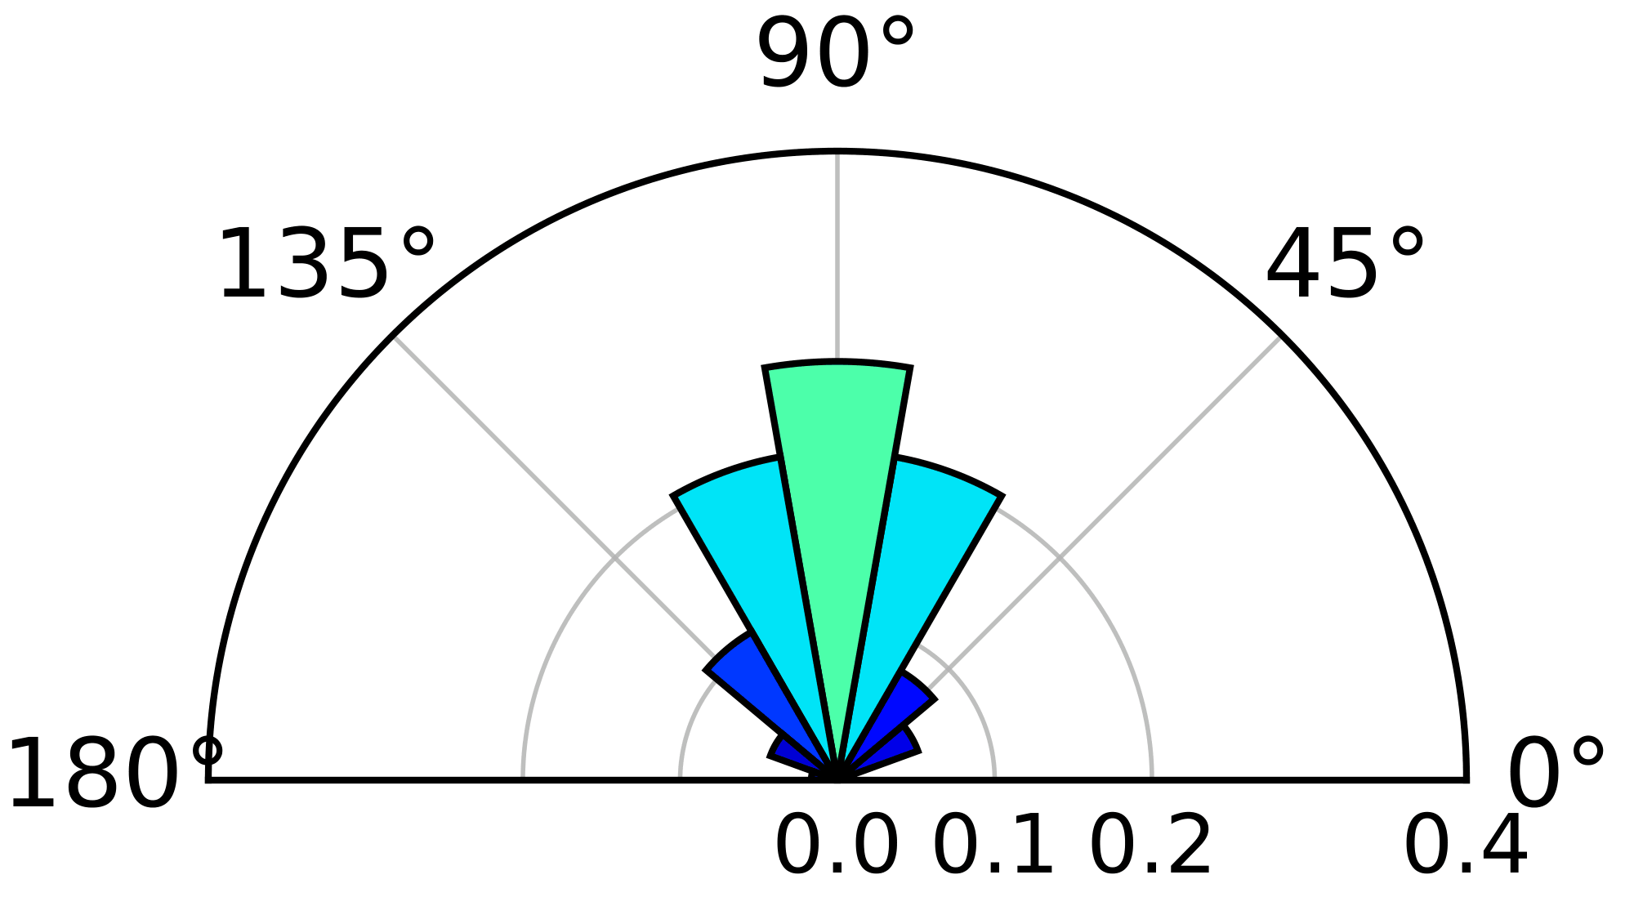
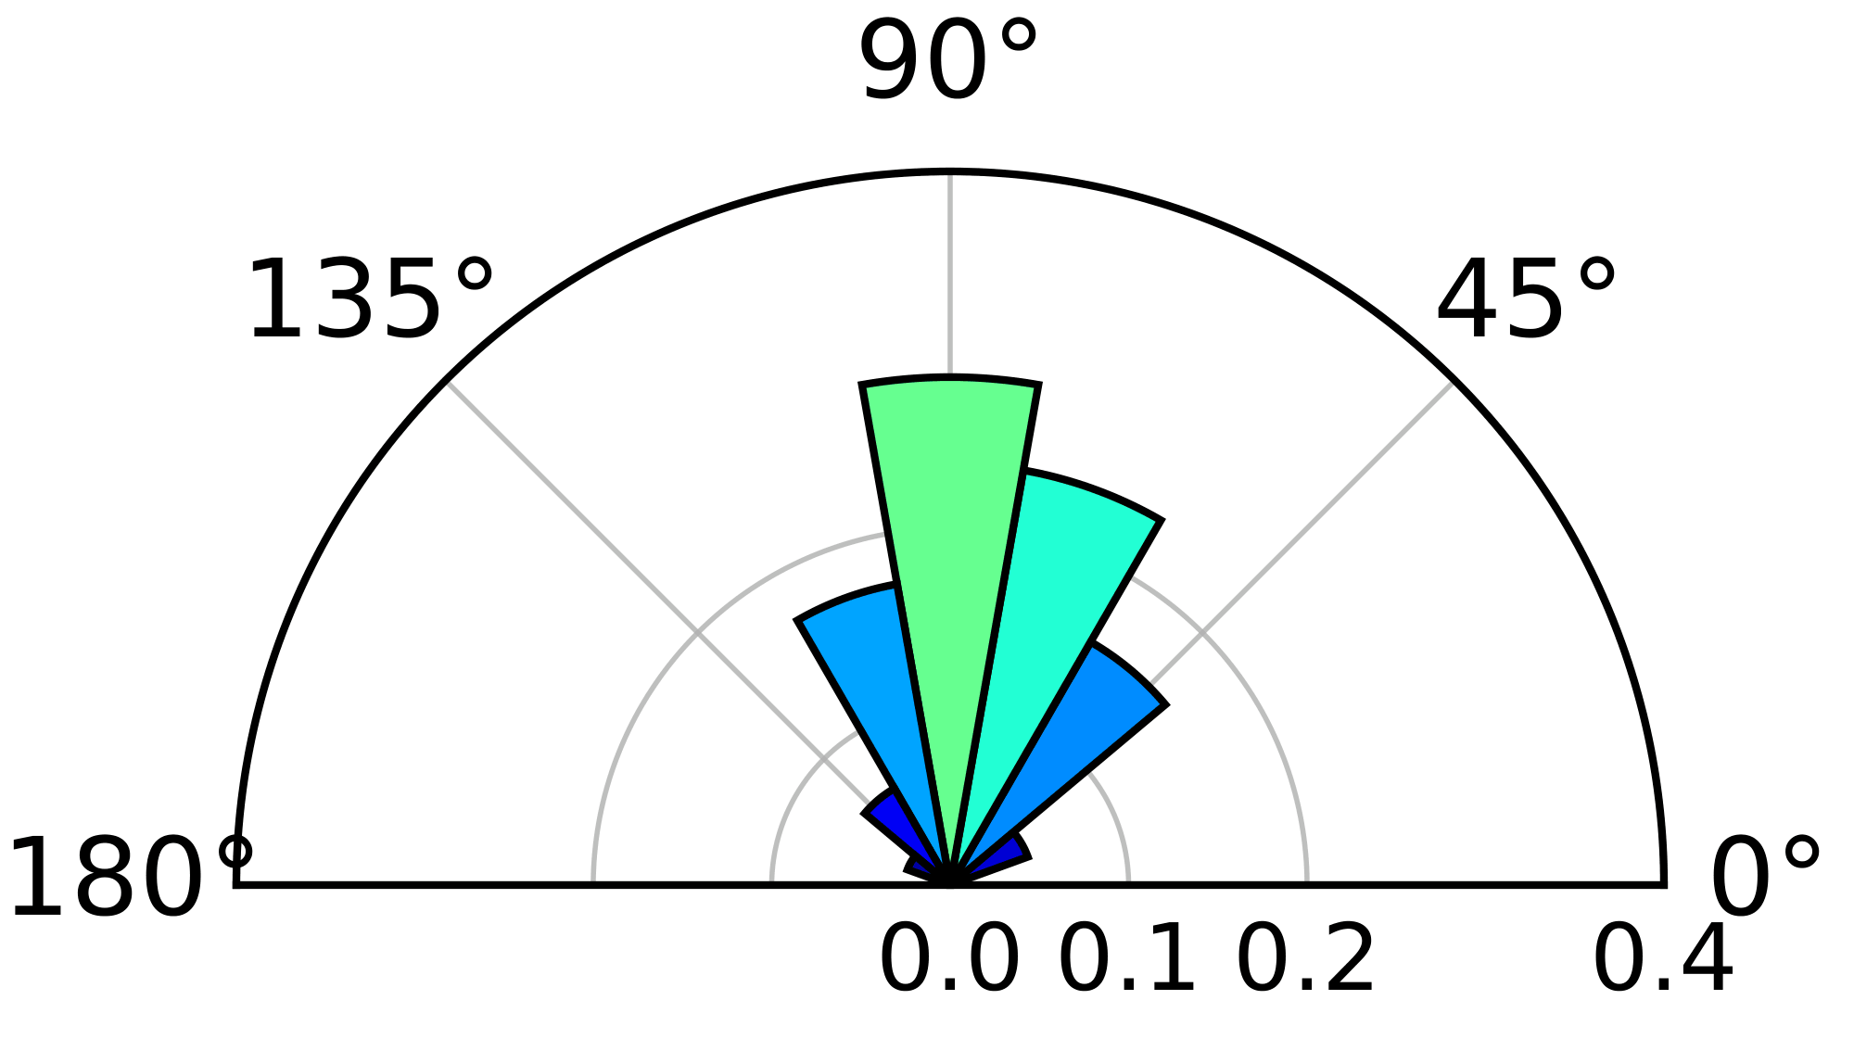
Centroid Angle by Cell
01
02
03
04
08
23

Slide 4
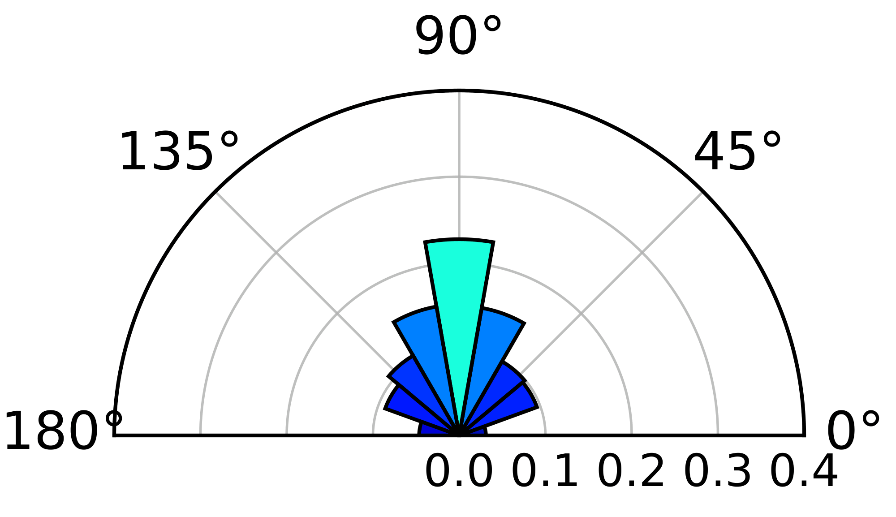
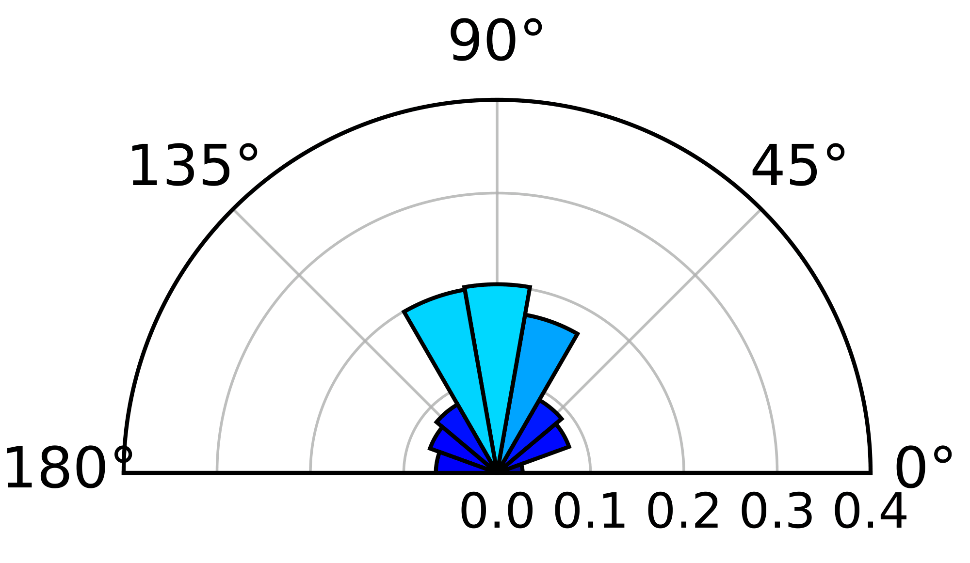
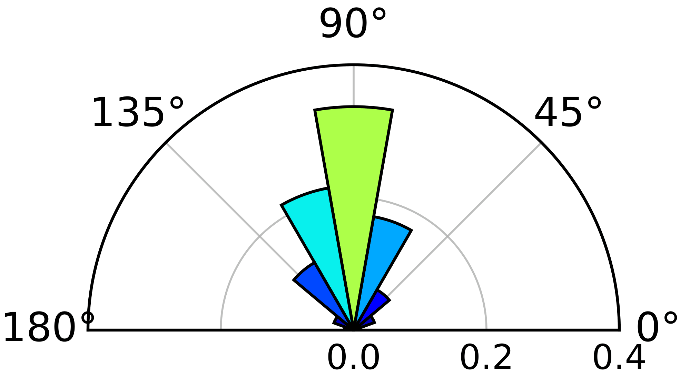
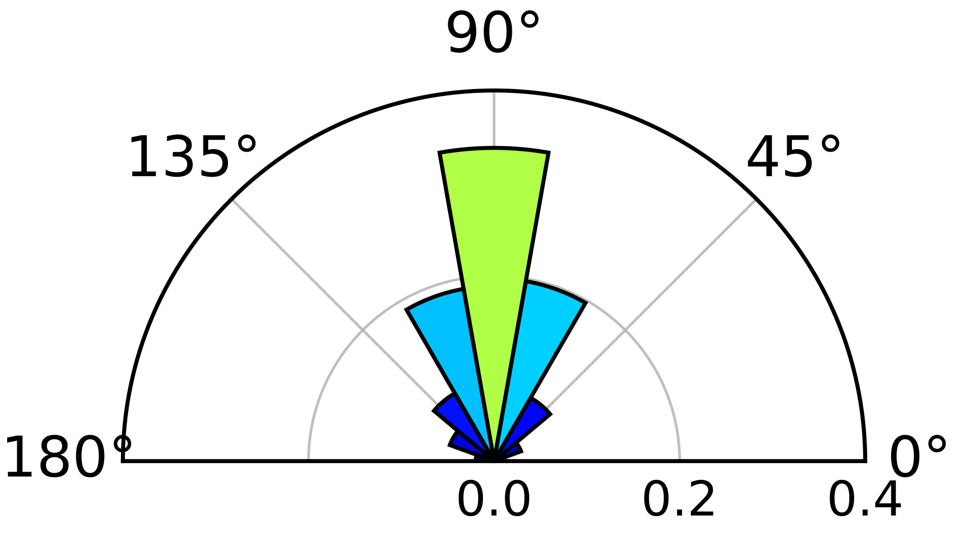
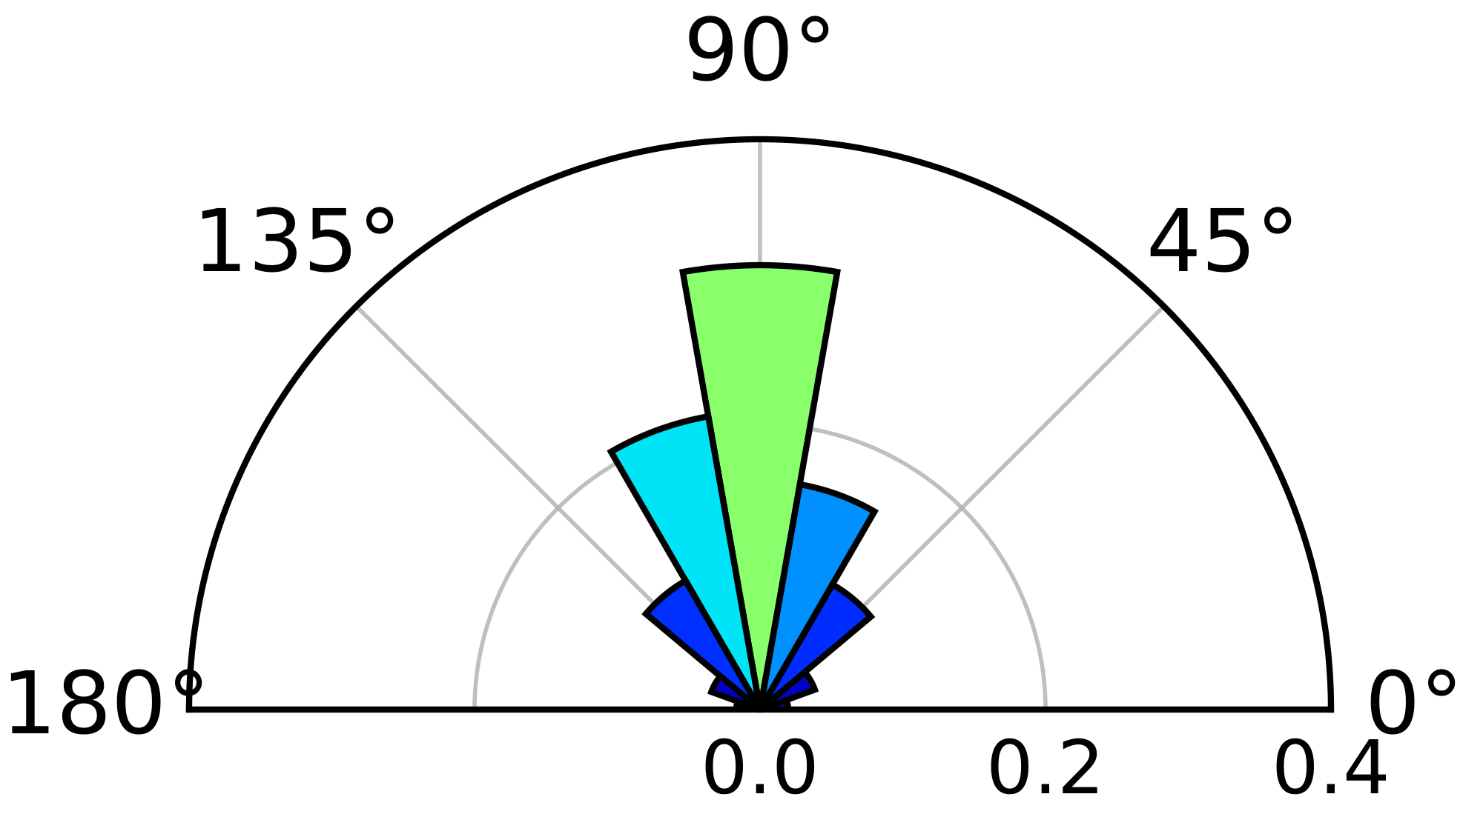

Surface Angle by Cell
01
02
03
04
08
23

Slide 5
Only the new ones
01
02
Centroid
Surface

Slide 6
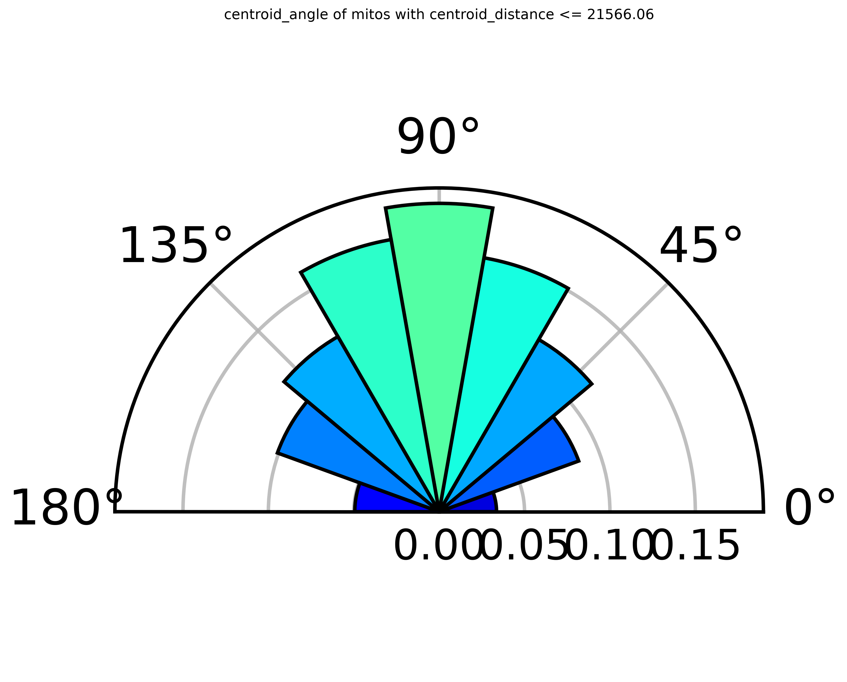
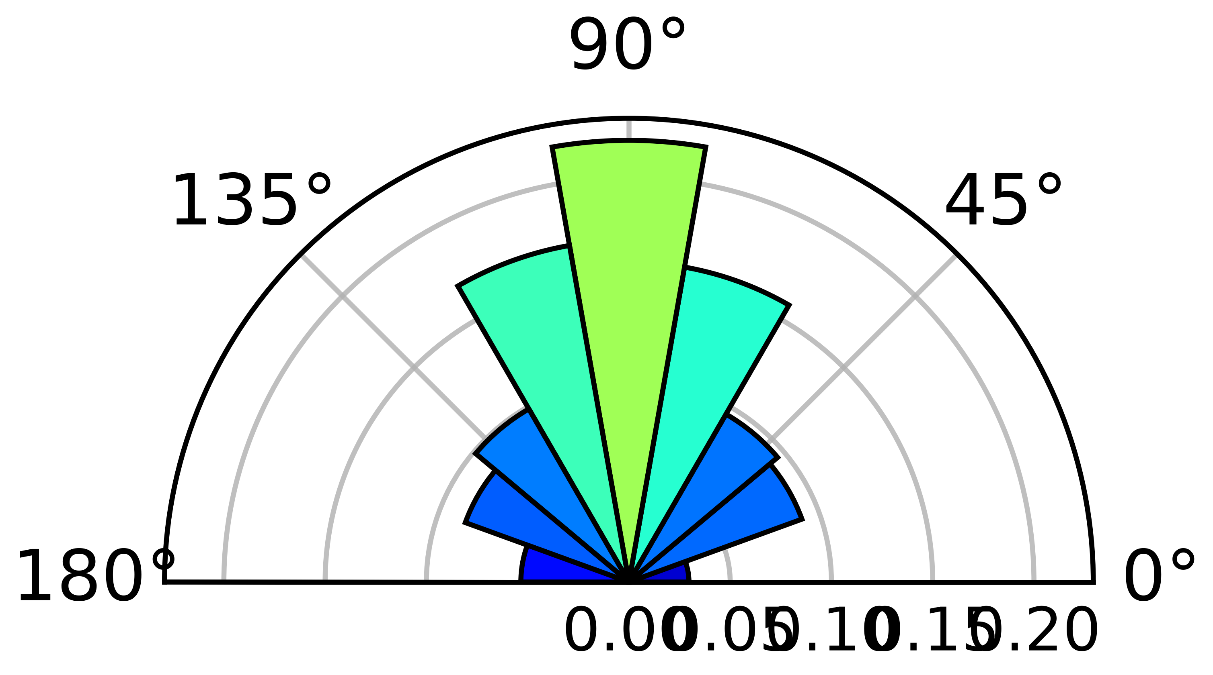
All mitochondria
New
Old
Centroid
Surface

Slide 7
Outlier features

Slide 8
Flagged Features

Slide 9
Flagged Features
Cell 01 | z | Cell 02 | z | Plain English
nucleus_volume | 2.53 |  |  | Volume of the nucleus
mitocloud_anisotropy | 10.20 | mitocloud_anisotropy | 4.50 | How elongated (like aspect ratio)
nucleus_mitocloud_L1 | 7.41 | nucleus_mitocloud_L1 | 5.19 | Spread along long axis
 |  | nucleus_mitocloud_L2 | 2.32 | Spread along mid axis
 |  | nucleus_distance_of_centroids | 2.29 | Distance between nuc centroid and mitocloud centroid
mito_volume_mean | -3.11 | mito_volume_mean | -2.55 | Mean volume of mitochondria
 |  | mito_volume_total | -2.55 | Total volume of all mitochondria
mito_surface_area_mean | -6.65 | mito_surface_area_mean | -6.14 | Mean surf. area of mitochondria
mito_centroid_distance_mean | 4.75 | mito_centroid_distance_mean | 4.19 | Mean mitochondria distance to nucleus centroid
mito_surface_distance_mean | 3.86 | mito_surface_distance_mean | 4.39 | Mean mitochondria distance to nucleus surface
mito_volume_fraction | -3.27 | mito_volume_fraction | -3.53 | Ratio of mitochondrial volume to nuclear volume

